Slide 1









Whiteboardmaths.com
7
2
1
5
© 2004 All rights reserved

Slide 2





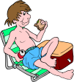
Two-Way Tables
Two-way tables are useful for displaying data in a clear and concise form.
In a survey on the popularity of visiting France and Holland, a sample of 100 Danish adults were asked for their holiday destinations last summer. In June 6 people went to France, 18 went to Holland and 5 went elsewhere. In July 10 people went to France, 19 went to Holland and 2 went elsewhere. In August 15 people went to France, 15 people went to Holland and 10 went elsewhere.
The information given above becomes much clearer if it is placed in a two-way table.
 | France | Holland | Elsewhere | Total
June
July
August
Total
6
18
5
29
10
19
2
31
15
15
10
40
31
52
17
100

Slide 3
Completing 1
Use the information in the table to answer the following:
 | France | Holland | Elsewhere | Total
June
July
August
Total
6
18
5
29
10
19
2
31
15
15
10
40
31
52
17
100
1. How many people visited Holland in July?
19
2. How many people visited France in August?
15
3. How many people went on holiday in June?
29
4. How many people went to Holland?
52
5. How many people did not visit France or Holland?
17

Slide 4
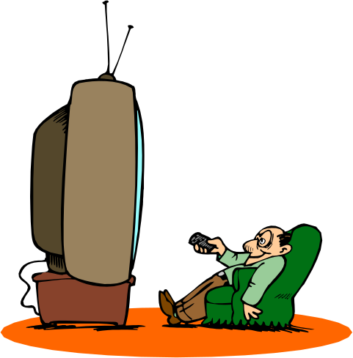
Completing 2
80 people were asked which one of three TV Channels they preferred to watch. Complete the partially filled two-way table below.
 | BBC 1 | ITV | CH 4 | Total
Male | 8 |  | 7 | 20
Female | 12 | 28
Total |  |  |  | 80
5
20
60
20
33
27

Slide 5


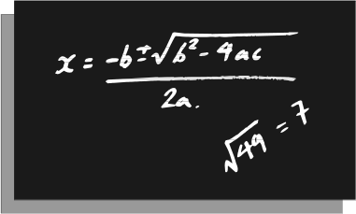
Completing 3
Some college students were asked to choose which of the three subjects, English, maths or science they enjoyed most. Complete the two-table below.
 | English | Maths | Sci | Total
Girls | 20 | 13 |  | 50
Boys |  | 15
Total | 38 |  | 40
17
18
23
56
28
106

Slide 6
Probability 1
You can use two-way tables to help solve probability problems:
 | France | Holland | Elsewhere | Total
June
July
August
Total
6
18
5
29
10
19
2
31
15
15
10
40
31
52
17
100
What is the probability that a person selected at random:
1. Went to Holland on holiday?
52/100
2. Went on holiday in July?
31/100
3. Went to France in August?
15/100
4. Did not visit either France or Holland?
17/100
5. Went on holiday in June?
29/100

Slide 7
Probability 2
80 people were asked which one of three TV Channels they preferred to watch. The results are given in the two-way table below.
 | BBC 1 | ITV | CH 4 | Total
Male | 8 |  | 7 | 20
Female | 12 | 28
Total |  |  |  | 80
5
20
60
20
33
27
What is the probability that a person selected at random:
1. Preferred BBC 1?
20/80
2. Preferred channel 4?
27/80
3. Was a male?
20/80
4. Was a female?
60/80
5. Was a male who preferred ITV?
5/80

Slide 8
Probability 3
Some college students were asked to choose which of the three subjects, English, maths or science they enjoyed most. The information is displayed in the two-way table below.
 | English | Maths | Sci | Total
Girls | 20 | 13 |  | 50
Boys |  | 15
Total | 38 |  | 40
17
18
23
56
28
106
What is the probability that a person selected at random:
1. Chose science as their favourite subject?
40/106
2. Chose English as their favourite subject?
38/106
3. Was a boy?
56/106
4. Was a girl who’s favourite subject was English?
20/106
5. Was a boy who’s favourite subject was maths?
15/106

Slide 9
Blank Tables

